Slide 1
Decorator Pattern

Slide 2
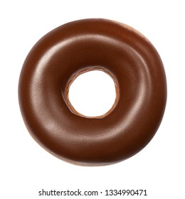
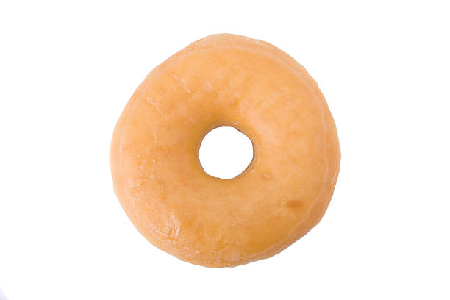
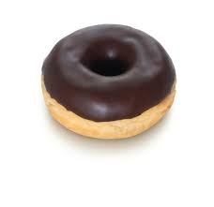
Regular Donuts with Chocolate Topping Decorator
Donut without topping
Topping Decorator
Mini Donuts wiyh Chocolate Topping

Slide 3
